Slide 1
SROS use case intro and project overview
ROS2 Security Workgroup presentation Secure Systems Research Centre (SSRC)
11th May 2021
1

Slide 2



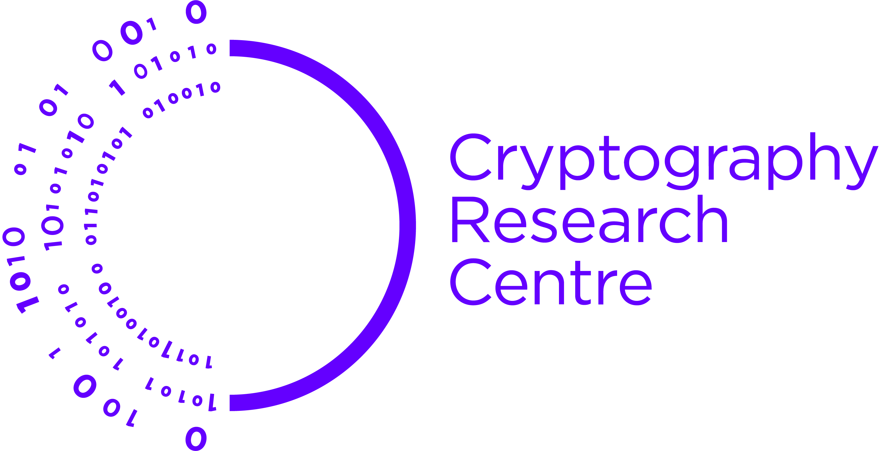



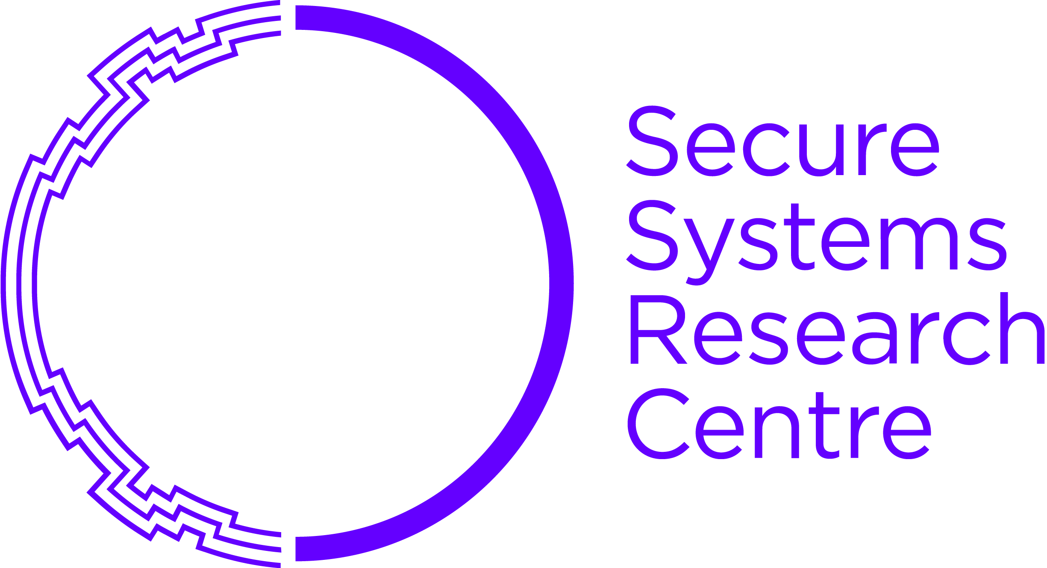



Research areas
QUANTUM
RESEARCH
CENTRE
AUTONOMOUS
ROBOTICS
RESEARCH
CENTRE
CRYPTOGRAPHY RESEARCH CENTRE
ADVANCED
MATERIALS RESEARCH CENTRE
DIGITAL
SECURITY
RESEARCH
CENTRE
DIRECTED ENERGY RESEARCH
CENTRE
SECURE
SYSTEMS
RESEARCH
CENTRE
EL2 Communities:

Slide 3



Hardware Hardening Against Tampering, Alternative Channels Resilience (Platforms)
Secure & Resilient Cloud Infrastructure
Secure Systems Research Centre
Software Hardening & Resilience
Against Malware
(OS, Apps, Cloud)
Secure & Resilient Platforms
(Vehicles, Phones)
Maintaining System Integrity
& Preventing Data Exfiltration
Secure & Resilient
Communications
Communication
Hardening Protocols, Alternative Networks Resilience

Slide 4




Secure Autonomous Systems
Only E2E Security and Resilience makes these Secure Autonomous Use Cases involving logistics and surveillance use possible
Secure delivery systems (e.g., vaccines)
Burning Building Connectivity to IOT and Smartphones
Emergency Response – Infrastructure-on-Fly (e.g., Earthquake)
Ground Pipeline Monitoring and Control
Underwater Monitoring

Slide 5
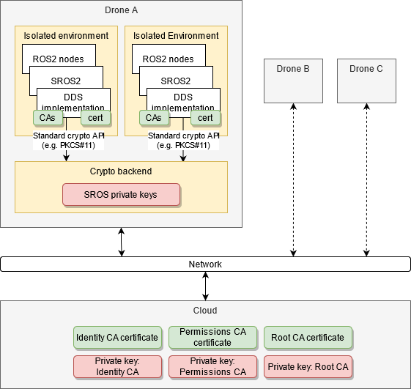
Drone architecture in ROS2 context
Currently using ROS2 Foxy and fastRTPS 2.0.2
Each drone runs ROS2 nodes in isolated environments
ROS2 nodes communicate inside and between drones
Crypto backend: a special environment that will not have ROS two nodes running. It works as an enclave to store the cryptographic keys. These keys never leave the enclave.
Cloud acts as the root of trust. Root CA and intermediate CAs reside in the cloud.
The signed ACLs (permissions) and environment’s identity cert can be uploaded to a drone during provisioning and configuration updates.

Slide 6
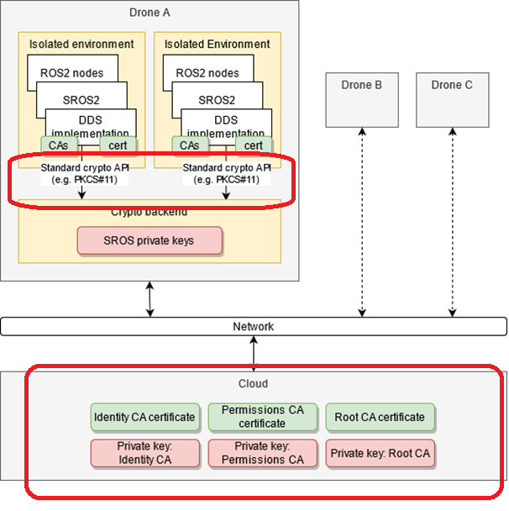
Open issues with current SROS setup
There are two identified issues for us to tackle with our SROS setup
Use of centralized PKI solution
Consume the identity keys that are stored in an enclave

Slide 7
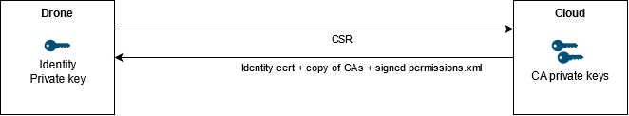
Use Case: External CA
CA and intermediate CAs on the cloud
Drone components to generate their own key pairs (on the enclave)
Drone components to generate the Certificate Signing Request (CSR) for their own authentication certificates
Copy-pasting the CSRs from drones to the cloud manually or part of existing provisioning data flows is OK
Sign drones’ authentication certificates on the cloud using Identity CA.
Sign permissions on the cloud using Permissions CA
Copy the signed auth certificates, signed ACL and CA certs back to the drone
Next steps: certificate revocation & revocation lists

Slide 8
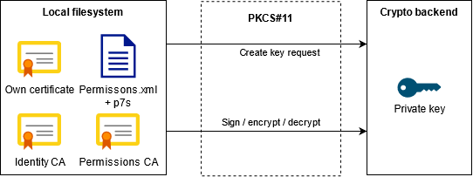
Use Case: Key protection with an enclave
VM’s private key to reside on the enclave and to be consumer over an API so that they key never leaves the enclave (e.g. PKCS#11)
Public components (e.g. the authentication certificates and CA files) are OK and preferred to stay in the local file system as they are today.

